Slide 1
Scale of the solar system
Year 7 Science

Slide 2
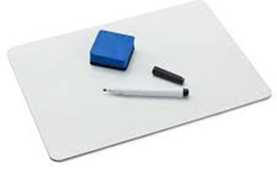
Review
Draw rotation vs revolution | Draw star vs planet vs moon
Draw terrestrial planet vs gas giant | Draw axis of Earth vs axis of Uranus.

Slide 3
Learning Intentions
Predictable phenomena on Earth, including seasons and eclipses, are caused by the relative positions of the Sun, Earth and the Moon.

Slide 4
Success criteria
Compare the scale of the planets to the scale of their orbits.
Use a model to represent both.

Slide 5
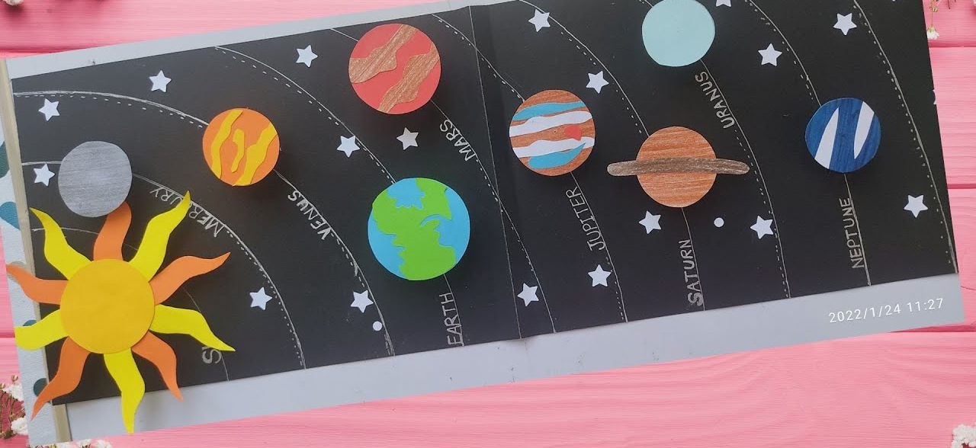
The scale of the planets

Slide 6
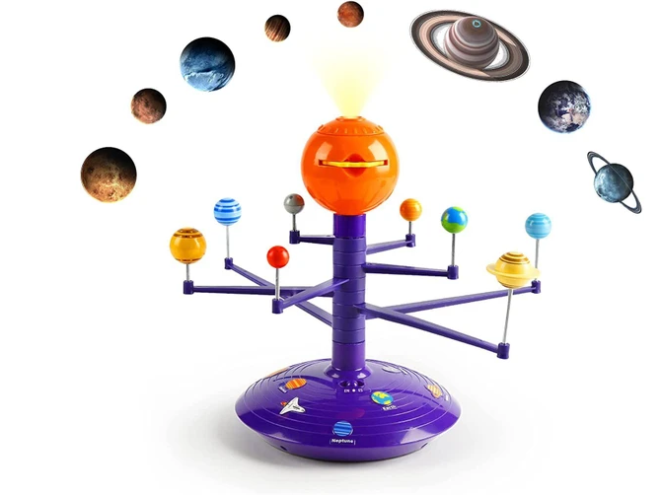
The orbits of the planets

Slide 7


Slide 8
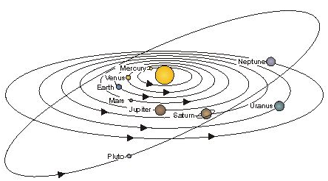

Slide 9
Activity: Model of the solar system
First, calculate your scale: 1 sheet of TP is 15 million km.
Don’t roll your whole TP out, just wind from one retort stand to another, so it does not break.
When you’re finished, roll it all back onto the original roll.

Slide 10
Success criteria
Compare the scale of the planets to the scale of their orbits.
Use a model to represent both.

